Slide 1


Slide 2

Skill 17
Web Development

Slide 3


Slide 4


Slide 5
Module Overview
 | C1 | C2 | C3
Morning | Module A Static Website Design 3h | Module C Backend API 3h | Module E Advanced Web Development 3h
Afternoon | Module B Backend SSR 4h | Module D Frontend 4h | Module F Collaborative Challenge 2h
Notes:
Module A: Implement a static website for a client. Competitors are given structure, breaktpoints. No render frameworks allowed!
Module B: Implement a backend with a database. The backend renders HTML pages.
Module C: Implement a backend which provides a REST API. The solution of module B will be provided (backend & database dump). Competitors have to extend the provided database.
Module D: Implement a frontend which consumes the REST API from Module C. The solution of module C will be provided.
Module E: Competitors will receive 3 separate tasks which all involve using native and advanced Web features that the browser provides. Frameworks will not be used.
Module F: Competitors form groups and collaboratively work on a creative idea and then present it to the other groups.

Slide 6
Module E

Slide 7
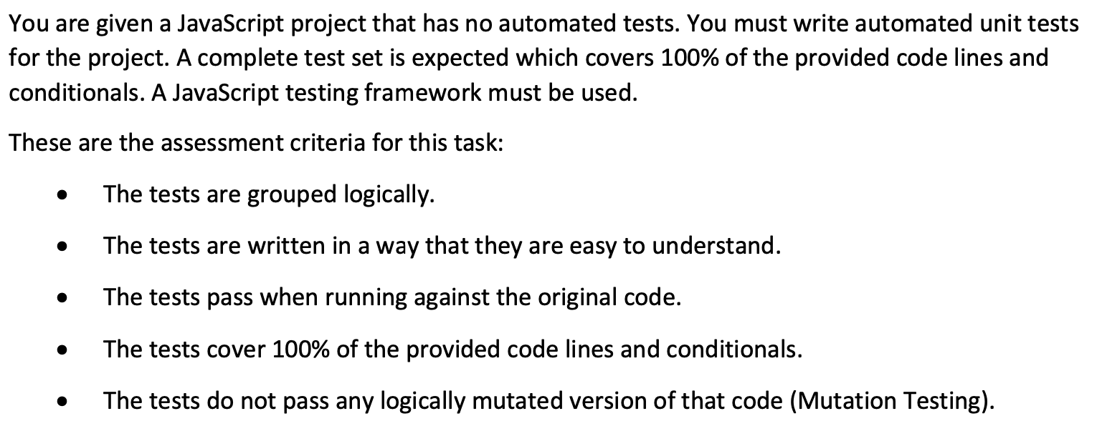
Module E - Task 1: Writing automated tests

Slide 8
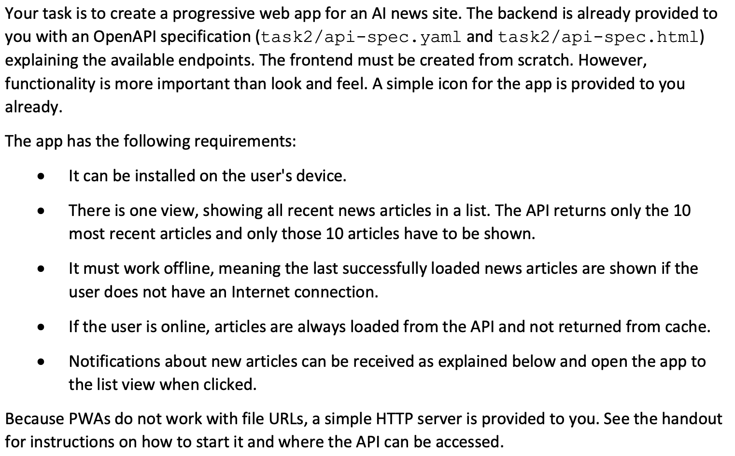
Module E - Task 2: Creating a Progressive Web App (PWA)

Slide 9
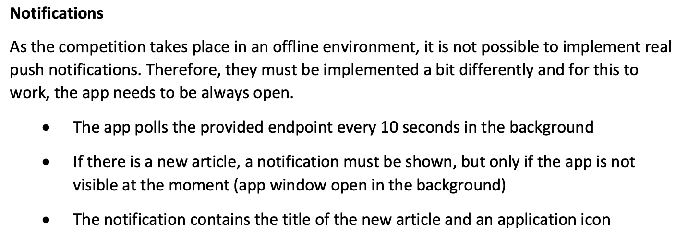
Module E - Task 2: Creating a Progressive Web App (PWA)

Slide 10
Module E - Task 3: Creating a Web Component

Slide 11
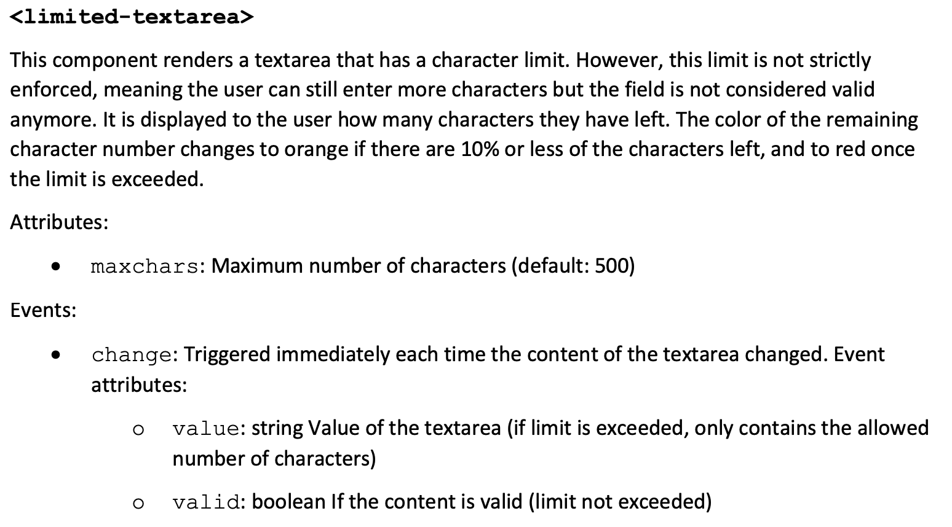
Module E - Task 3: Creating a Web Component

Slide 12
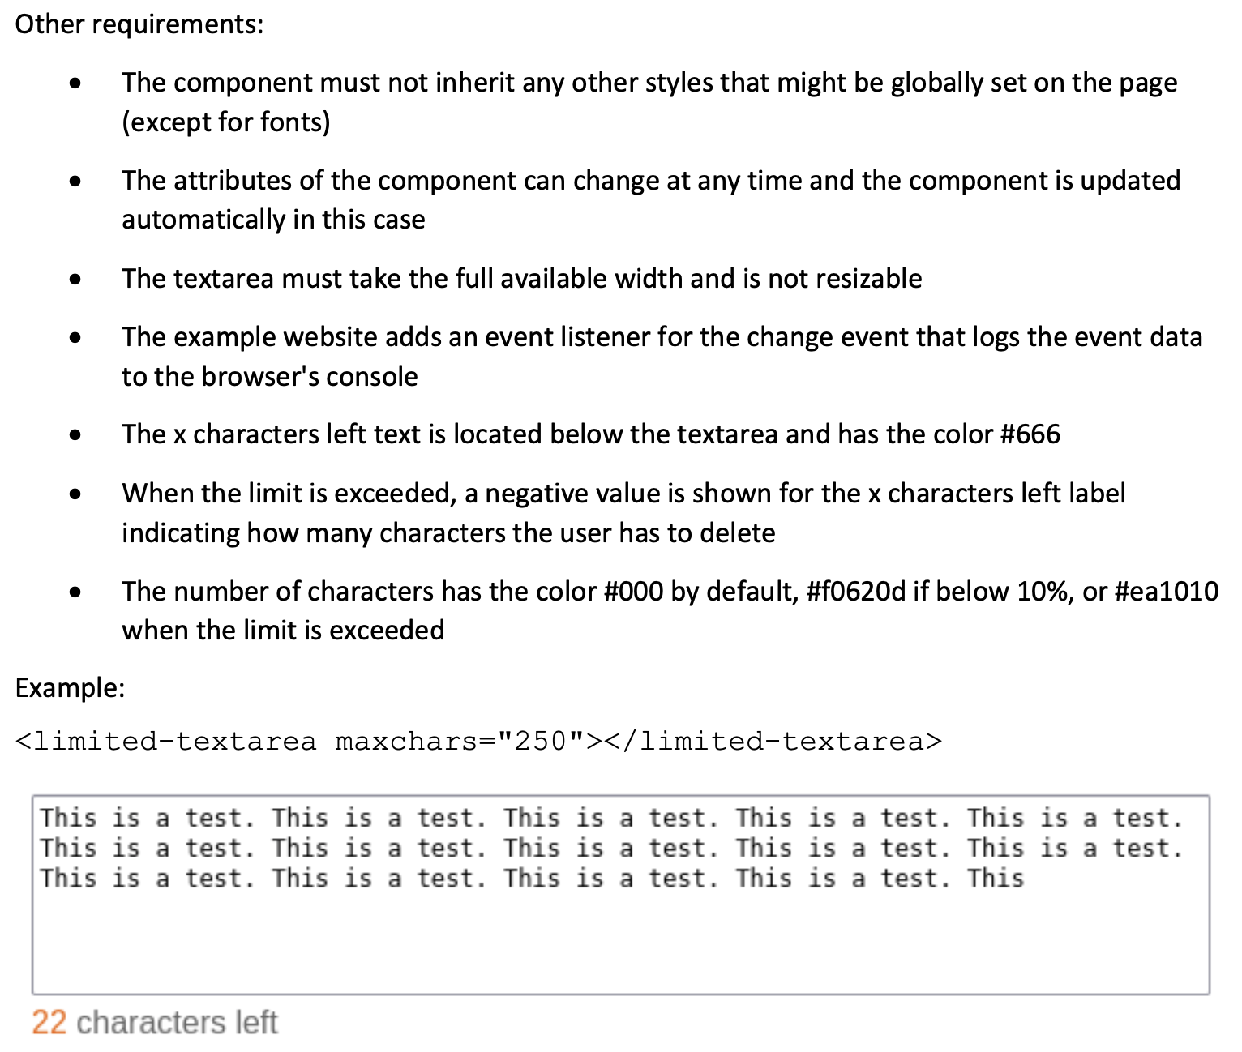
Module E - Task 3: Creating a Web Component

Slide 13
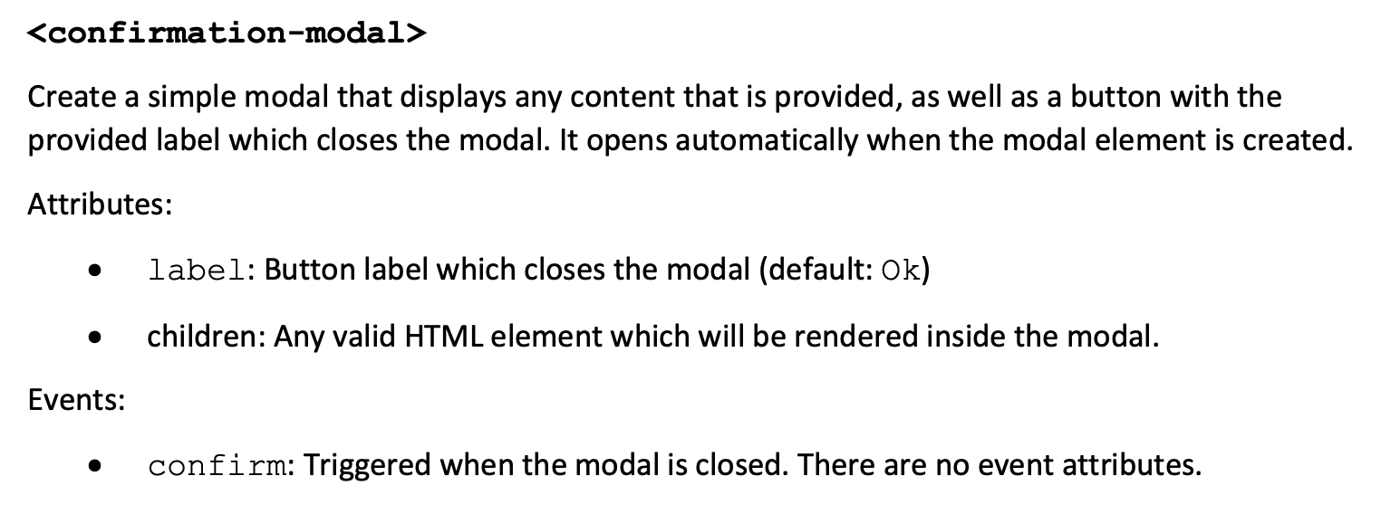
Module E - Task 3: Creating a Web Component

Slide 14
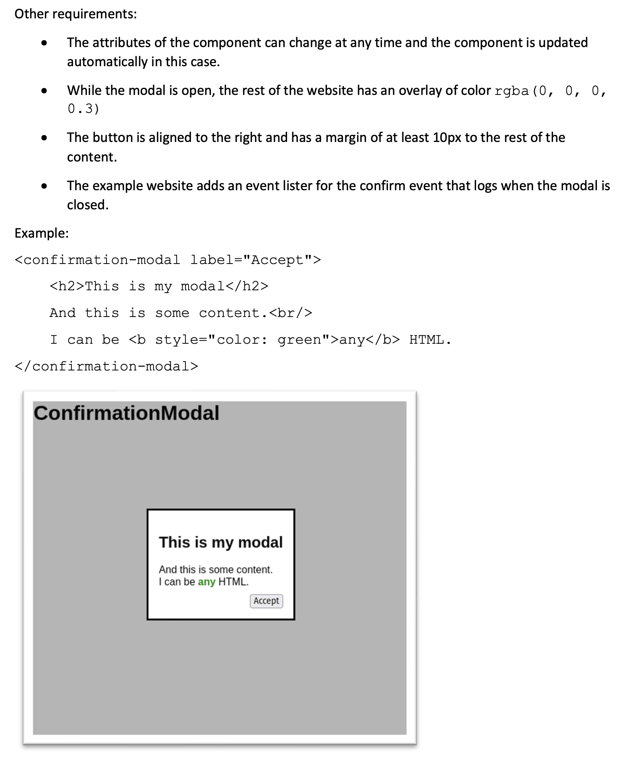
Module E - Task 3: Creating a Web Component

Slide 15
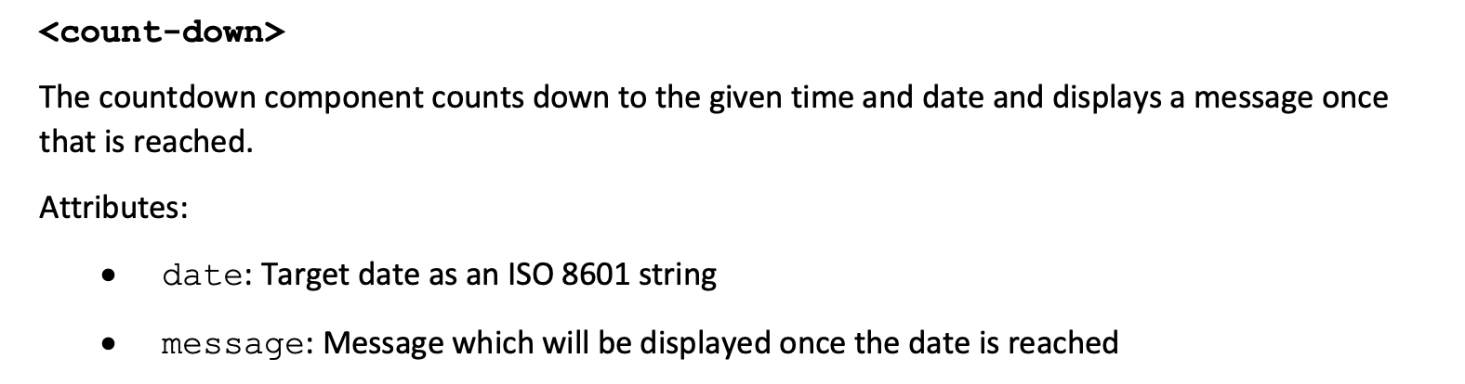
Module E - Task 3: Creating a Web Component

Slide 16
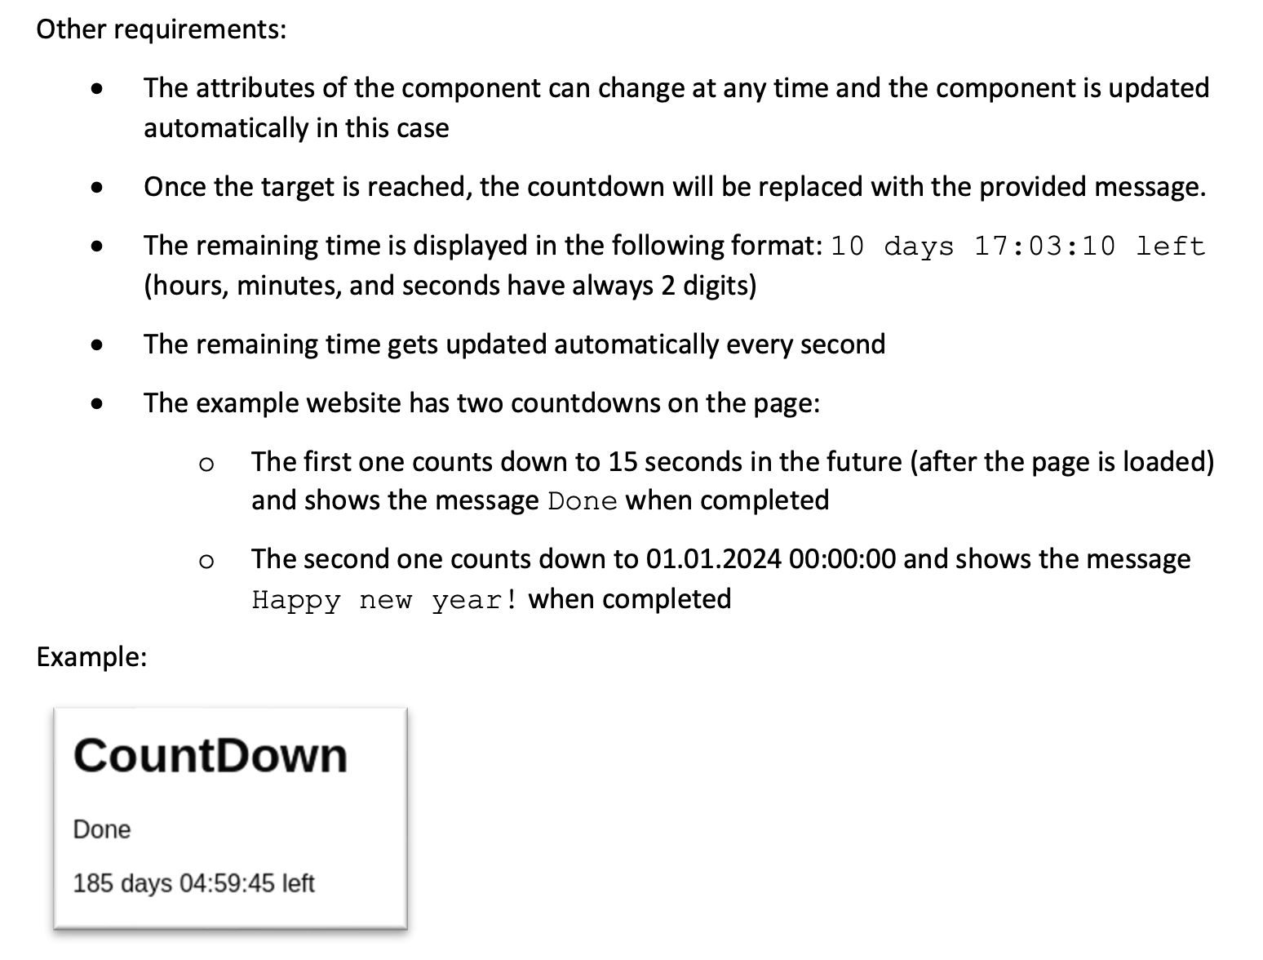
Module E - Task 3: Creating a Web Component

